Slide 1
Classification of Biomedical Abstracts:
PubMed vs. BioRxiv
IS590ML Final Presentation Tre Tomaszewski, Sayantan Dutta, Xiaoliang Jiang

Slide 2
Background
Biorxiv is a pre-press article repository, similar to Arxiv but pertaining to the biomedical sciences
By posting preprints, authors are able to make their findings immediately available to the scientific community and receive feedback on draft manuscripts before they are submitted to journals.
PubMed is a published paper repository for the biomedical sciences.
PubMed provides free access to MEDLINE and links to full text articles when possible.
MEDLINE contains journal citations and abstracts for biomedical literature from around the world.

Slide 3
Motivation
Using the paper abstracts alone, can a paper from Biorxiv and Pubmed, controlling for topics, be correctly classified between to a significant* degree, using terms alone?
This would indicate that there is a difference between the two sources worth further investigation.

Slide 4
Hypothesis
No significant difference exists
between PubMed abstracts and Biorxiv abstracts.

Slide 5
Prior Research
Work prior to 2019 used manual processes for text analysis
Klein, M., Broadwell, P., Farb, S. E., & Grappone, T. (2018). Comparing published scientific journal articles to their pre-print versions. International Journal on Digital Libraries. https://doi.org/10.1007/s00799-018-0234-1
Amaral, O. B. (March 20, 2018). Comparing quality of reporting between preprints and peer-reviewed articles – a crowdsourced initiative. Retrieved March 8, 2019, from ASAPbio website: https://asapbio.org/amaral-quality
Carneiro, C. F. D., Queiroz, V. G. S., Moulin, T. C., Carvalho, C. A. M., Haas, C. B., Rayêe, D., … Amaral, O. B. (March 22, 2019). Comparing quality of reporting between preprints and peer-reviewed articles in the biomedical literature [Preprint]. https://doi.org/10.1101/581892

Slide 6
Methodology - Collection
Two different methods were required to collect the abstracts:
PubMed offers an official Entrez API (using a wrapper from Biopython) with extensive search capabilities
Biorxiv has no API, but does have a rather clean and consistently formatted website!
Equal instances of each topic from either source were collected.
Topics were mapped via PubMed’s MeSH thesaurus
Duplicate Articles were removed
Articles were randomly sampled for equal instance count for each topic
The final corpus consists of 35461 instances (~55MB uncompressed)

Slide 7
Methodology - Initial Preprocessing
PubMed returned structured XML, whereas Biorxiv was pure web-based HTML
The native Python XML parsers and the Python packages Beautiful Soup and Requests were used for extraction of the abstracts

Slide 8
Methodology - Document Preprocessing
Therefore, a custom preprocessing pipeline was required:
Raw text was saved as json files
Custom preprocessing:
set all text to lowercase,
removed tabs, new lines, and carriage returns,
Numbers,
Email Addresses,
URLs,
Punctuation,
And other associated characters (e.g., ^, ;, &, {}, etc.)
Text was broken into words, or terms
Stopwords were excluded, as were words under a prespecified length (4 for the final)
Individual terms were lemmatized using the WordNet Lemmatizer, using the Python NLTK package

Slide 9
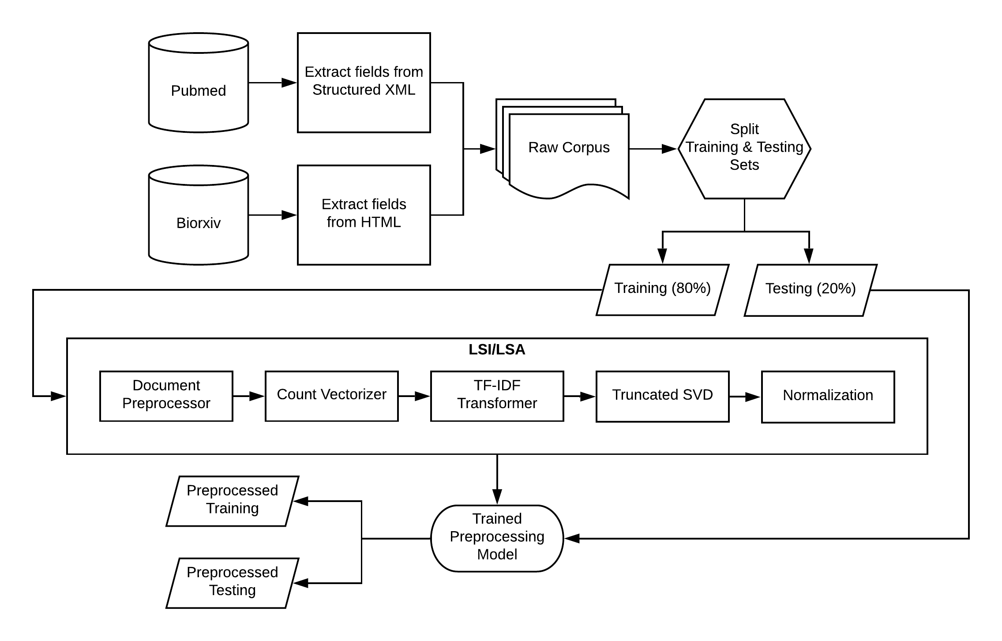
Methodology - Feature Selection Pipeline

Slide 10
Methodology - Feature Selection Pipeline
Initial vectorization of training instances was restricted to:
Terms with a document frequency less than 65%
Terms with a total document occurrence of more than 25
10000 features (5847 unique terms returned)

Slide 11
Methodology - Feature Selection Pipeline
The pipeline was structured as a typical Latent Semantic Indexer/Analyzer (LSI/LSA):
The count vector was then passed to a TF-IDF transformer
Extracted singular values from the transformed matrix using Truncated SVD
Several component counts were tested
5000 components returned a 97.95% total explained variance
Output was normalized and stored as a dataframe
Appended article ID for reference back to the original document and label

Slide 12
Methodology - Feature Selection Pipeline
Before being fed through the pipeline, the corpus was split 80/20:
80% of the original corpus was used as the training set (28368 instances)
20% was set aside for the final testing (7093 instances)
The LSI pipeline was fit to the testing set only
Training the preprocessing pipeline took 15 minutes

Slide 13
Methodology - Transformation Example
Background: Cardiometabolic affections greatly contribute to the global burden of disease. The susceptibility to these conditions associates with the ancestral genetic composition and gut microbiota. However, studies explicitly testing associations between genetic ancestry and gut microbes are rare. We examined whether the ancestral genetic composition was associated with gut microbiota, and split apart the effects of genetic and non-genetic factors on host health. ...
background cardiometabolic affection contribute global burden disease susceptibility condition ancestral genetic composition microbiota study explicitly test genetic ancestry microbe rare examine whether ancestral genetic composition microbiota split apart effect genetic genetic factor host health

Slide 14
Methodology - Classification
4 classifiers were attempted:
Gaussian Naive Bayes
Random Forest
Logit
Linear Support Vector Machine
C=0.001, 0.01, 0.1, 1.0, 10.0 -> 1.0 worked best
Naive Bayes and Logit took very little time
Of these, Logit and SVM provided the best results

Slide 15
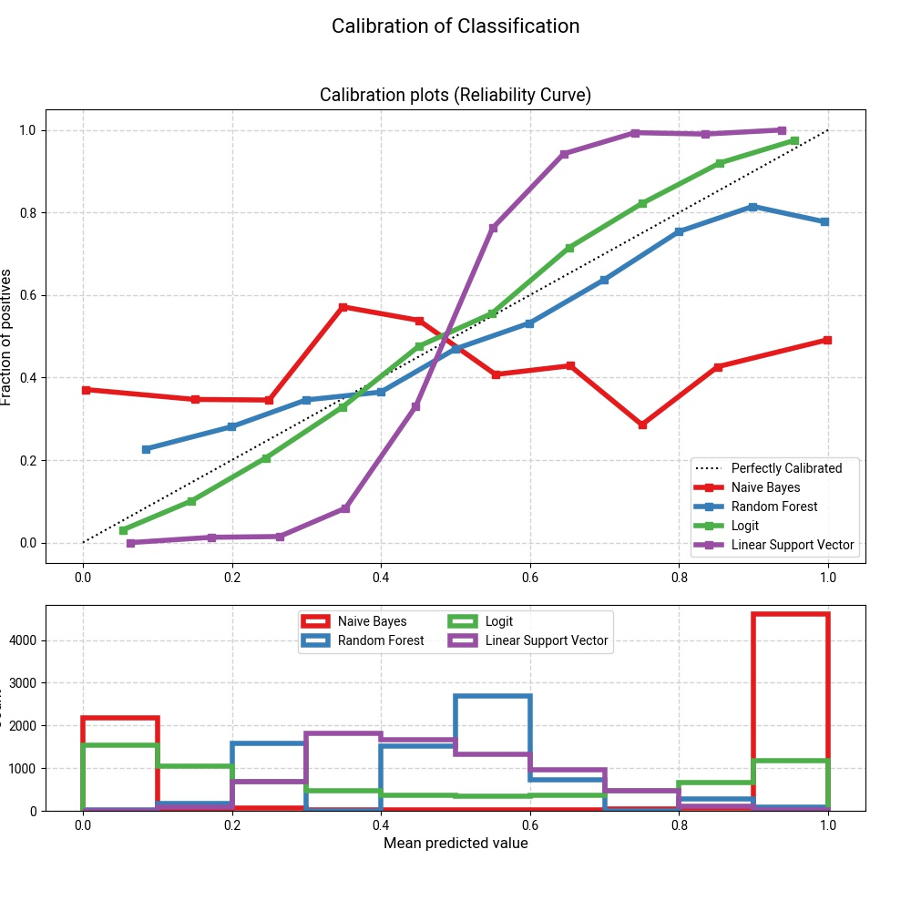
Results - Classifier Calibration

Slide 16
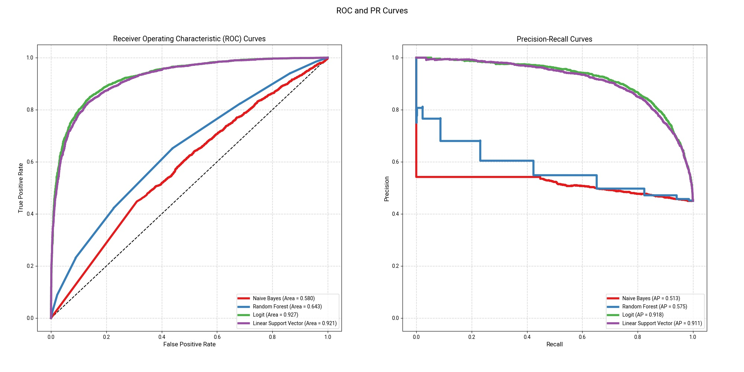
Results - ROC and PR curves

Slide 17
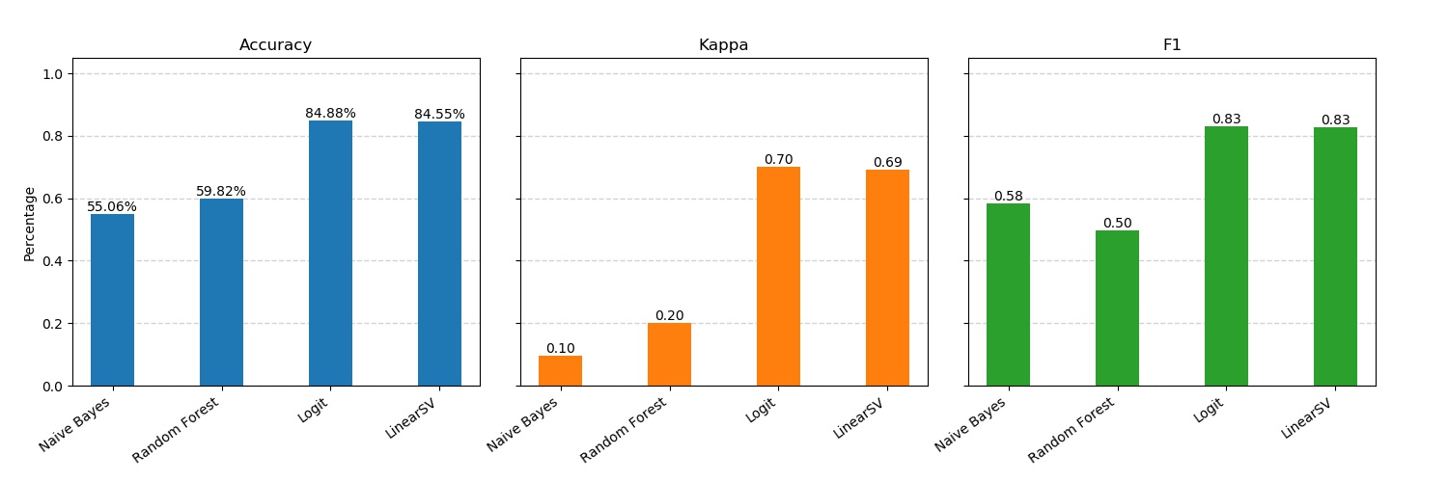
Results - Stats

Slide 18
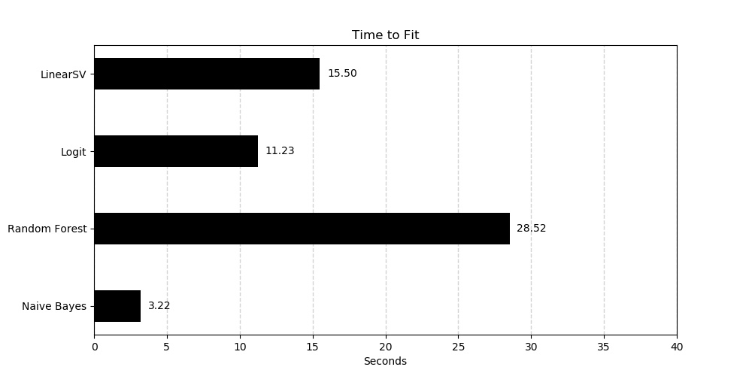
Results - Fit Time

Slide 19
Discussion
Results suggest non-random classification is possible
Presently, only minimal analysis...
Source/term analysis shows possible points of bias

Slide 20
Findings
An inconclusive difference exists
between PubMed abstracts and Biorxiv abstracts, but skepticism pertaining to the validity of the results remains.

Slide 21
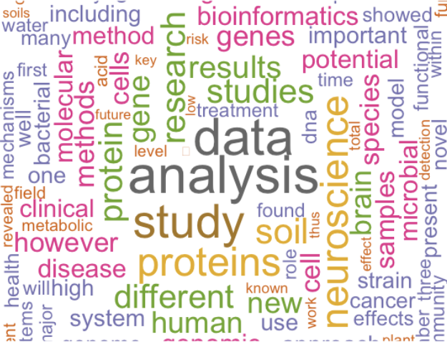
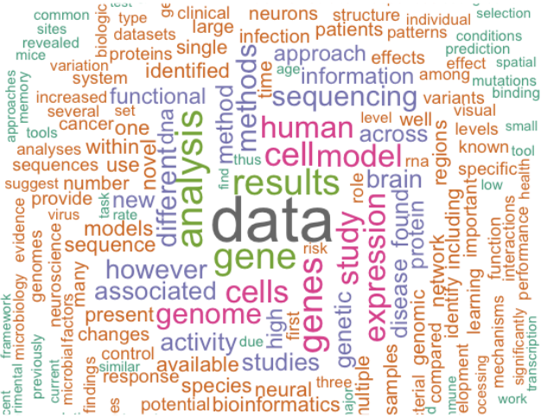
Discussion
Overview of terms before preprocessing:
Word Cloud of PubMed
Word Could of Biorxiv

Slide 22
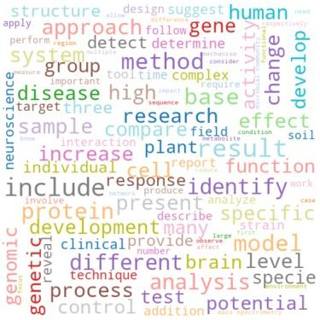
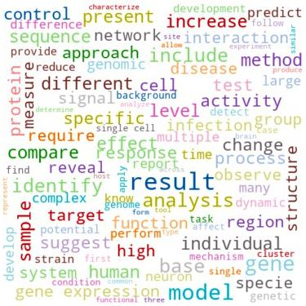
Discussion
Word Cloud for PubMed
Word Cloud for Biorxiv

Slide 23
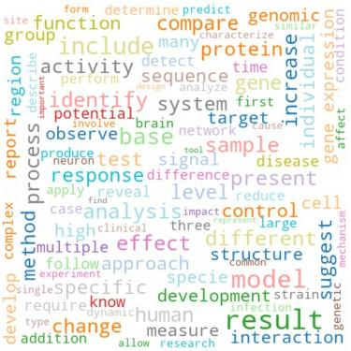
Discussion
Word Cloud for PubMed

Slide 24
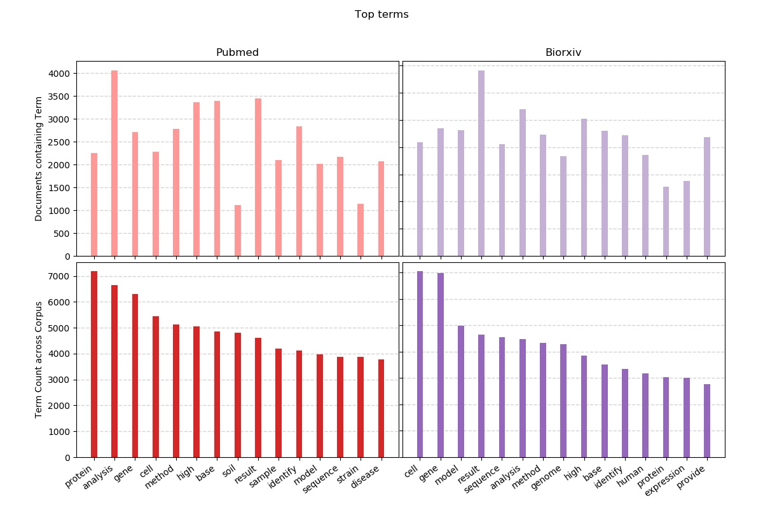
Discussion - High Frequency Terms

Slide 25
Future Work
Further analysis of terms within documents
Why is there a difference between the two sources?
Are some terms improperly indicative of the source?
Use part-of-speech tags along with terms
Try other classifiers (e.g., Bagging, non-linear SVC, k-Neighbors, NN, etc.)
Use Word Vectors instead of Bag-of-Words

Slide 26
Appendix- Terms (Reach for your microscope!)
aacr, aberrant, ability, abiotic, able, abnormal, abnormality, abnormally, abolish, abrupt, absence, absent, absolute, absorption, abstract, abstraction, abundance, abundant, abuse, academia, academic, academy, accept, acceptable, acceptance, accepted, acceptor, access, accessibility, accessible, accession, accessory, accompany, accomplish, accord, accordance, accordingly, account, accounting, accumbens, accuracy, acetic, acetyl, acetylcholine, achievable, achieve, achievement, achieves, acid, acidic, acidity, acidobacteria, acinetobacter, acknowledge, acoustic, acquire, acquisition, across, act, actin, actinobacteria, actinomycete, action, actionable, active, actively, activity, actual, actually, acuity, acute, acutely, acyl, adapt, adaptability, adaptable, adapted, adaptive, adaptor, add, added, addiction, addictive, addition, additional, additionally, additive, address, adenocarcinoma, adenosine, adenovirus, adhd, adhere, adherence, adhesion, adipose, adjacent, adjust, adjusted, adjustment, adjuvant, administer, admission, admit, admixture, adni, adolescence, adolescent, adopt, adoption, adsorption, adult, adulthood, advance, advanced, advancement, advantage, advantageous, advent, adverse, adversely, adversity, aedes, aegypti, aerial, aerobic, aeromonas, aerosol, aeruginosa, aetiology, affect, affected, affective, afferent, affinity, afford, affordable, aforementioned, africa, african, agar, age, aged, ageing, agency, agent, aggression, aggressive, aging, agnostic, agonist, agree, agreement, agricultural, agriculture, ahead, aid, aim, airborne, airway, alanine, albeit, albicans, albumin, alcohol, alcoholic, alert, algae, algal, algorithm, algorithmic, algorithms, align, aligner, aligners, alignment, alike, alkaline, allele, alleles, allelic, allen, allergen, allergic, allergy, allosteric, allow, allows, alone, along, alongside, alpha, alphaproteobacteria, already, alter, altered, alters, altitude, altogether, alveolar, alzheimer, alzheimers, amazon, ambient, ambiguity, ambiguous, amenable, amend, amendment, america, american, amine, amino, aminobutyric, aminophospholipid, ammonia, ammonium, amoa, amongst, amount, ampa, ampicillin, amplicon, amplicons, amplified, amplify, amplitude, amygdala, amyloid, amyotrophic, anaerobic, analog, analogous, analogue, analyse, analysis, analyst, analytes, analytic, analytical, analytically, analytics, analyze, analyzed, analyzer, ancestor, ancestral, ancestry, anchor, ancient, andor, androgen, anesthesia, anesthetized, aneuploidy, angiogenesis, angle, angular, animal, anion, anisotropy, anniversary, annual, annually, anomaly, anopheles, anova, anoxic, answer, antagonism, antagonist, antagonistic, antarctic, antarctica, anteiso, anterior, anthropogenic, anti, antibacterial, antibiotic, antibody, anticancer, antidepressant, antifungal, antigen, antigenic, antigens, antimicrobial, antioxidant, antipsychotic, antiretroviral, antisense, antiviral, anxiety, apache, apart, apical, apoe, apolipoprotein, apoptosis, apoptotic, apparent, apparently, appeal, appear, appearance, appetitive, apple, applicability, applicable, application, applied, apply, approach, approval, approve, approved, april, aquaculture, aqueous, arabidopsis, arbitrarily, arbitrary, arbovirus, arbuscular, archaea, archaeal, archaeological, architectural, architecture, archive, arctic, area, areal, arena, arginine, args, arguably, argue, argument, arid, arise, arises, arm, aroma, around, arousal, arrange, arrangement, array, arrest, arrival, arrive, arsenal, arsenic, artefact, arterial, artery, arthritis, arthropod, article, artifact, artificial, artificially, ascend, ascertain, ascomycota, ascribe, asexual, asia, asian, ask, aspect, aspergillus, ass, assay, assemblage, assemble, assembled, assembler, assembly, assess, assessed, assessment, assign, assignment, assist, association, assume, assumption, assurance, asthma, astrocyte, asymmetric, asymmetry, asymptotic, asynchronous, atac, ataxia, atcc, atherosclerosis, atlantic, atlas, atmosphere, atmospheric, atom, atomic, atopic, atpase, atrophy, attach, attachment, attack, attain, attainment, attempt, attend, attended, attention, attentional, attitude, attract, attractive, attractor, attributable, attribute, attribution, atypical, audience, auditory, augment, august, aureus, australia, australian, author, authority, autism, autistic, auto, autoantibody, autochthonous, autoimmune, autoimmunity, autonomic, autonomous, autophagy, autosomal, autosome, autotrophic, auxiliary, availability, available, avenue, average, aversive, avian, avium, avoid, avoidance, awake, award, aware, awareness, away, ax, axial, axis, axon, axonal, baby, bacillus, back, backbone, background, backward, bacteria, bacterial, bactericidal, bacteriophage, bacterium, bacteroides, bacteroidetes, bad, balance, balanced, band, bangladesh, bank, barcode, barcoded, barcodes, barcoding, barley, barr, barrel, barrier, basal, base, baseline, basic, basin, basis, baumannii, bayes, bayesian, bdnf, beach, bead, beadchip, bean, bear, bearing, become, becomes, bee, beef, begin, beginning, behave, behaving, behavior, behavioral, behaviorally, behaviour, behavioural, behind, beijing, being, belief, believe, belong, belonging, belongs, belowground, bench, benchmark, benchmarked, benchmarking, beneficial, benefit, benign, besides, best, beta, better, beverage, beyond, bias, biased, bidirectional, big, bile, billion, bin, binary, bind, binding, binning, binocular, binomial, bioactive, bioaerosol, bioaerosols, bioassay, bioavailability, biobank, biochar, biochemical, biochemically, biochemistry, bioconductor, biocontrol, biodiversity, biofilm, biofilms, biofuel, biogenesis, biogeochemical, biogeography, biologic, biological, biologically, biologist, biology, biomarker, biomarkers, biomass, biomedical, biomolecular, biomolecules, biophysical, biophysically, biopsy, bioscience, biosensor, biosphere, biosynthesis, biosynthetic, biotechnological, biotechnology, biotic, biotin, bipartite, biphasic, bipolar, bird, birth, bisulfite, bite, black, blactx, bladder, blast, blend, blind, blindness, block, blockade, blocker, blood, bloodstream, bloom, blot, blotting, blue, blueprint, blunt, blup, board, bodily, body, bold, bona, bond, bone, bonferroni, book, boost, bootstrap, border, born, borne, bottle, bottleneck, bottom, bound, boundary, bout, bovine, bovis, bowel, brain, brainstem, branch, branching, brazil, brazilian, brca, breadth, break, breakdown, breakpoint, breakpoints, breakthrough, breast, breed, breeder, breeding, bridge, brief, briefly, bright, bring, british, broad, broaden, broadly, broiler, broth, brown, browse, browser, bruijn, bud, budding, budget, buffer, build, building, bulb, bulk, bundle, burden, burkholderia, burn, burst, bypass, byproduct, cadmium, caenorhabditis, cage, cajal, calcium, california, call, called, caller, callosum, camera, camp, campaign, campylobacter, canada, canadian, cancer, cancerous, candida, canine, canonical, capability, capable, capacity, capillary, capital, capsid, capsule, captive, capture, carbapenem, carbapenemase, carbon, carcass, carcinogenesis, carcinoma, card, cardiac, cardiovascular, care, career, careful, carefully, cargo, carlo, carriage, carrier, carry, cascade, case, casein, casp, caspase, cassette, cast, caudal, causal, causality, causally, cause, causing, caution, cavity, cblj, cctcc, cdna, cell, cellular, cellulose, census, center, central, centrality, centrally, centre, centric, centromere, century, cephalosporin, cereal, cerebellar, cerebellum, cerebral, cerebrospinal, cerebrovascular, cereus, cerevisiae, certain, certainly, cervical, cfug, cfuml, cgmcc, chain, chair, challenge, challenging, chamber, chance, change, changing, channel, chaperone, chapter, character, characterise, characteristic, characterize, characterized, charge, charles, chart, cheap, check, checklist, checkpoint, cheese, chemical, chemically, chemistry, chemogenetic, chemokine, chemosensory, chemotaxis, chemotaxonomic, chemotherapy, chicken, chikungunya, child, childhood, childrens, chimeric, chimpanzee, china, chinese, chip, chitin, chloride, chlorine, chloroflexi, chlorophyll, chloroplast, choice, cholera, cholerae, cholesterol, choline, cholinergic, choose, chosen, chromium, chromosomal, chromosome, chronic, chronically, chronological, ciprofloxacin, circadian, circle, circuit, circuitry, circular, circumstance, circumvent, cite, city, clade, cladosporium, claim, clamp, clarify, clarity, class, classic, classical, classically, classified, classifier, classify, classroom, clean, cleaning, clear, clearance, clearly, cleavage, cleave, click, client, clinic, clinical, clinically, clinician, clip, clock, clonal, clone, cloning, close, closed, closely, closer, clostridium, closure, cloud, clue, cluster, clustered, clustering, cnns, cnvs, coalescent, coarse, coast, coastal, cocaine, cocktail, cod, code, coding, codon, coefficient, coeruleus, coevolution, coexist, coexistence, coexpression, cofactor, cognition, cognitive, cognitively, coherence, coherent, cohesin, cohesive, cohort, coil, coincide, coincident, cold, coli, coliforms, colistin, colitis, collagen, collapse, colleague, collect, collection, collective, collectively, college, colliculus, colombia, colon, colonise, colonize, colony, color, colorectal, colour, column, combine, combined, come, command, commensal, comment, commentary, commercial, commercially, commit, commitment, committee, common, commonality, commonly, communicable, community, comorbid, comorbidities, comorbidity, compact, companion, company, comparable, compare, comparison, compartment, compartmental, compel, compelling, compendium, compete, competence, competency, competent, competition, competitive, competitor, compile, complement, complementarity, complementary, complete, completely, completeness, completion, complex, complexity, compliance, component, compose, composite, composition, compositional, compost, compound, comprehension, comprehensive, comprehensively, compress, compression, comprise, comprises, comprising, compromise, compulsive, compute, computer, computing, conceive, concept, conception, conceptual, conceptualize, conceptually, concern, concert, concerted, conclude, conclusion, conclusions, concomitant, concordance, concordant, concrete, concurrent, concurrently, condition, conditional, conditioned, conditioning, conduct, conductance, conduction, conductivity, cone, confer, conference, confers, confidence, confident, confidently, configure, confine, confirm, confirmed, conflict, confocal, conform, confound, confounders, confounding, confront, confusion, congenital, congress, congruent, conjunction, connect, connected, connection, connectivity, connectome, connectomes, connectomics, conscious, consciousness, consecutive, consensus, consent, consequence, consequent, consequently, conserve, conserved, consider, considerable, considerably, considers, consist, consistency, consistent, consistently, consisting, consists, consortium, constant, constantly, constituent, constitute, constitutive, constitutively, constrain, constraint, construct, construction, consume, consumer, consuming, consumption, contact, contain, container, containing, contains, contaminant, contemporary, content, context, contextual, contig, contigs, contiguity, contiguous, continent, continental, contingency, contingent, continually, continue, continued, continuity, continuous, continuously, continuum, contour, contract, contraction, contradictory, contrary, contrast, contribute, contributes, contributing, contribution, contributor, control, controlled, controversial, controversy, convenience, convenient, conventional, conventionally, converge, convergence, convergent, conversely, conversion, convert, convey, convolution, convolutional, cool, cop, cope, copper, copy, coral, cord, core, corn, cornerstone, coronary, corpus, correct, correction, correctly, correctness, correspond, correspondence, corresponding, corresponds, cortex, cortical, cortico, corticospinal, cost, costly, cotton, council, count, counter, counteract, counterpart, counting, country, county, couple, coupled, coupling, course, covalent, covalently, covariance, cover, coverage, cow, cpgs, cran, cranial, credible, criminal, crisis, crispr, crisprcas, criterion, critical, critically, crohns, crop, cross, crosslinking, crossover, crosstalk, crucial, crucially, crude, cryo, cryptic, cryptococcus, crystal, ctcf, cue, cultivar, culturable, cultural, culture, cultured, cumbersome, cure, current, currently, curriculum, curve, custom, customizable, customize, customized, cut, cutaneous, cutoff, cxcl, cxcr, cyanobacteria, cyanobacterial, cycle, cyclic, cycling, cyst, cysteine, cystic, cytochrome, cytokine, cytomegalovirus, cytometry, cytoplasm, cytoplasmic, cytoscape, cytosine, cytoskeletal, cytoskeleton, cytosol, cytosolic, cytotoxic, cytotoxicity, daily, dairy, damage, damaging, danger, dark, data, database, datasets, daughter, david, dawley, day, dead, deadly, deal, decade, decay, december, decide, decipher, decision, decisive, declare, decline, decode, decoder, decoding, decompose, decomposition, deconvolution, decouple, decrease, decreased, decreasing, deduce, deem, deep, deepen, deeper, deeply, default, defect, defective, defence, defend, defense, defensive, deficiency, deficient, deficit, define, defined, definition, definitive, degrade, degraded, degrader, degree, degs, dehydrogenase, delay, delayed, delete, deleterious, deletion, deliver, delivery, delta, demand, dementia, demographic, dendrite, dendritic, dengue, denmark, denoising, denote, dense, densely, density, dental, denv, department, depend, dependence, dependency, dependent, depends, depict, deplete, depletion, deploy, deployment, deposit, deposition, depress, depression, depressive, deprive, deps, depth, derive, derived, descend, descent, describe, described, description, descriptive, descriptor, deseq, desert, deserve, design, desirable, desire, desired, desktop, desorption, despite, destruction, detail, detailed, detect, detectable, detected, detection, detector, detects, detergent, determinant, determine, determines, deterministic, detrimental, develop, developed, developer, developing, development, developmental, developmentally, device, devise, devoid, devote, dgge, diabetes, diabetic, diagnose, diagnosis, diagnostic, diagnostics, diagram, dialogue, diameter, diamino, diaminopimelic, diarrhea, die, diet, dietary, differ, difference, differences, different, differential, differentially, differently, differs, difficile, difficult, difficulty, diffraction, diffuse, diffusion, diffusivity, dige, digest, digestion, digestive, digit, digital, dilemma, dilute, dilution, dimension, dimensional, dimensionality, dimer, dimethyl, diminish, diminished, dimorphic, dimorphism, dioxide, diploid, direct, directed, direction, directional, directly, director, disability, disadvantage, disappear, disc, discard, discern, discharge, disciplinary, discipline, disclose, discordance, discordant, discover, discovery, discrepancy, discrete, discriminant, discus, discuss, discussion, disease, diseased, diseases, disentangle, disequilibrium, disinfection, disk, dismutase, disorder, disordered, disparity, dispensable, dispersal, disperse, dispersion, displacement, display, dispute, disrupt, disruption, disruptive, disrupts, dissect, dissection, dissimilar, dissimilarity, dissociable, dissolution, dissolve, dissolved, distal, distance, distant, distantly, distinct, distinction, distinctive, distinctiveness, distinctly, distinguish, distinguishable, distinguishes, distort, distortion, distractor, distress, distribute, distributed, distribution, district, disturb, disturbance, diverge, divergence, divergent, diverse, diversify, diversity, divide, division, dlpfc, dmrs, dnase, dock, docker, docking, doctor, doctrine, document, documented, dog, domain, domains, domestic, dominance, dominant, donor, door, dopamine, dopaminergic, dormant, dorsal, dos, dosage, dose, double, doubt, download, downstream, dozen, draft, drain, drastic, drastically, draw, drawback, dream, dried, drift, drink, drinking, drive, driven, driver, driving, drop, droplet, dropout, drosophila, drought, drug, druggable, dry, dsrna, dual, ductal, dust, dwell, dye, dynamic, dynamical, dynamically, dysbiosis, dysfunction, dysfunctional, dystrophy, earlier, early, earth, ease, easily, east, eastern, easy, ebola, echo, ecoli, ecological, ecologically, ecology, economic, economical, economically, economics, economy, ecosystem, ecosystems, ectomycorrhizal, ectopic, edaphic, edge, edible, edit, editing, edition, editor, editorial, effect, effective, effectively, effectiveness, effector, efficacious, efficacy, efficiency, efficient, efficiently, effluent, efflux, effort, egfr, egg, eight, eighteen, elastic, elderly, electric, electrical, electrically, electro, electrochemical, electrode, electroencephalogram, electroencephalographic, electroencephalography, electron, electronic, electrophoresis, electrophysiological, electrophysiology, electrospray, elegans, element, elementary, eleven, elicit, eligible, elisa, elsewhere, elusive, elution, embed, embedding, embody, embrace, embryo, embryogenesis, embryonic, embryos, emerge, emergence, emergency, emergent, emerges, emission, emit, emotion, emotional, emphasis, emphasise, emphasize, empirical, empirically, employ, empower, enable, enables, encephalitis, encode, encoded, encodes, encoding, encompass, encounter, encourage, encyclopedia, end, endanger, endeavor, endemic, endocrine, endocytosis, endogenous, endonuclease, endophytic, endoplasmic, endospore, endothelial, endow, endpoint, endure, energetic, energy, engage, engagement, engine, engineer, engineered, engineering, england, english, enhance, enhanced, enhancement, enhancer, enhances, enjoy, enormous, enrich, enriched, enrichment, enrol, ensembl, ensemble, ensue, ensure, entail, enter, enteric, enterica, enteritidis, enterobacter, enterobacteriaceae, enterococci, enterococcus, enterovirus, entire, entirely, entitle, entity, entorhinal, entrainment, entropy, entry, envelope, environment, environmental, environmentally, envision, enzyme, enzymes, epidemic, epidemiologic, epidemiological, epidemiologically, epidemiologist, epidemiology, epidermal, epigenetic, epigenetically, epigenetics, epigenome, epigenomic, epigenomics, epilepsy, epileptic, episode, episodic, epistasis, epithelial, epithelium, epitope, epitopes, epoch, epstein, eqtl, eqtls, equal, equally, equilibrium, equip, equipment, equivalent, erps, erroneous, error, erythrocyte, esbl, escape, escherichia, essay, essence, essential, essentiality, essentially, establish, establishment, ester, estrogen, ethanol, ethic, ethical, ethiopia, ethnic, ethnicity, ethyl, etiological, etiology, eukaryote, eukaryotes, eukaryotic, europe, european, evade, evasion, even, evenness, event, eventual, eventually, ever, every, everyday, evidence, evident, evoke, evoked, evolution, evolutionarily, evolutionary, evolve, ewas, exact, exactly, examine, example, examples, exceed, excellent, except, exception, exceptional, exceptionally, excess, excessive, exchange, excision, excitability, excite, exciting, exclude, exclusion, exclusive, exclusively, execute, execution, executive, exemplify, exercise, exert, exhaustive, exhibit, exist, existence, existing, exists, exit, exogenous, exome, exomes, exon, exonic, exosomes, expand, expanded, expansion, expect, expectancy, expected, expedite, expense, expensive, experience, experienced, experiment, experimental, experimentally, expert, expertise, explain, explicit, explicitly, exploit, explore, explosion, exponential, exponentially, export, expose, exposed, exposure, express, expressed, expression, extant, extend, extended, extensible, extension, extensive, extensively, extent, external, externally, extinction, extra, extracellular, extract, extracted, extraction, extraordinary, extreme, extremely, extrinsic, eye, face, facet, facial, facility, fact, factor, factorial, factory, faculty, faecal, faecalis, faecium, fail, failure, fair, fairly, faithfully, falciparum, fall, false, familial, familiar, family, famous, farm, farmer, farming, fasciculus, fashion, fast, fasta, faster, fastq, favor, favorable, favorably, favour, fear, feasibility, feasible, feature, february, fecal, feces, fee, feed, feedback, feedforward, feeding, feeling, fell, fellow, female, ferment, ferret, fertility, fertilize, fertilizer, fetal, fetus, fever, few, ffpe, fiber, fibre, fibroblast, fibrosis, fide, fidelity, field, fifteen, fifth, fifty, fight, figure, filament, filamentous, file, fill, film, filter, filtering, final, finally, financial, find, finding, fine, finger, fingerprint, fingerprinting, finish, finite, fire, firing, firmicutes, first, firstly, fish, fisher, fission, fit, fitness, fitting, five, fix, fixed, flag, flagellar, flagellum, flank, flash, flavivirus, flavobacterium, flavonoid, flavor, flavour, flaw, flexibility, flexible, flexibly, flight, flood, floor, flora, flow, flower, flowering, fluid, fluorescence, fluorescens, fluorescent, fluoroquinolone, flux, fly, fmri, focal, focus, focused, fold, folding, follicular, follow, following, food, foodborne, foot, footprint, forage, force, forced, forebrain, forecast, foreign, forensic, forest, forget, form, formal, formalin, formalize, formally, formation, former, formerly, forming, formula, forty, forward, foster, found, founder, four, fourier, fourteen, fourth, fraction, fractional, fracture, fragile, fragment, fragmented, frame, framework, france, free, freedom, freely, freeze, french, frequency, frequent, frequently, fresh, friend, friendly, front, frontal, frontier, fronto, frontoparietal, frozen, fructose, fruit, fruitful, fuel, fulfil, fulfill, full, fully, function, functional, functionality, functionally, functioning, fund, fundamental, fundamentally, funding, fungal, fungi, fungicide, fungus, furthermore, fusarium, fuse, fusiform, fusion, future, g+ccontent, gaba, gabaergic, gain, gait, galactose, galaxy, game, gamma, gammaproteobacteria, ganglia, ganglion, gap, garden, gastric, gastroenteritis, gastrointestinal, gaussian, gaze, gblup, gel, genbank, gender, gene, genealogy, general, generalizability, generalizable, generalize, generalized, generally, generic, genesis, genetic, genetically, genetics, genic, genome, genomes, genomic, genomically, genomics, genotype, genotyped, genotypic, genotyping, genuine, genus, geochemical, geographic, geographical, geographically, geography, geometric, geometry, germ, german, germany, germline, get, giant, github, give, gland, glass, glia, glial, glioblastoma, glioma, global, globally, globe, glomerular, glucocorticoid, glucose, glucosidase, glutamine, glycan, glycans, glycerol, glycine, glycolipid, glycolipids, glycolysis, glycolytic, glycoprotein, glycoside, go, goal, gold, golden, golgi, gondii, good, google, govern, government, gplv, grade, gradient, gradual, gradually, graft, grain, gram, granger, grant, granular, granule, grape, graph, graphic, graphical, grasp, grass, grassland, gravity, gray, green, greenhouse, grey, grid, gross, ground, group, grouping, grow, grown, grows, growth, gtex, gtpase, guanine, guarantee, guidance, guide, guided, guideline, guinea, gwas, gyrb, gyrus, habit, hair, half, hallmark, halophilic, hamper, hand, handful, handle, handling, haploid, haplotype, hapmap, happen, harbor, harbour, hard, hardly, hardware, harm, harmful, harness, harsh, harvest, hazard, head, headache, health, healthcare, healthy, hear, hearing, heart, heavily, heavy, hebbian, height, heighten, hela, helical, helicobacter, helix, helminth, help, helper, helpful, hemagglutinin, heme, hemisphere, hemispheric, hemodynamic, hemoglobin, hemorrhagic, hence, hepg, herbicide, herd, hereditary, herein, heritability, heritable, herpes, herpesvirus, heterogeneity, heterogeneous, heterogenous, heterologous, heterotrophic, heterozygosity, heterozygous, heuristic, hidden, hide, hierarchical, hierarchically, hierarchy, high, higher, highlight, highly, hinder, hinders, hint, hippocampal, hippocampus, hiseq, histidine, histological, histology, histone, historic, historical, historically, history, hit, hitherto, hkac, hkme, hold, holistic, holstein, home, homeostasis, homo, homogeneity, homogeneous, homogenous, homolog, homologous, homologs, homologue, homologues, homology, homozygosity, homozygous, hop, hope, horizon, horizontal, horizontally, hormonal, hormone, horn, horse, hospital, hospitalize, host, hotspot, hour, house, household, housekeep, housing, hplc, hub, huge, human, humidity, humoral, hundred, huntington, hurdle, hybrid, hydrocarbon, hydrogen, hydrolase, hydrolysis, hydrolyze, hydrophilic, hydrophobic, hydrophobicity, hydroxylase, hygiene, hyper, hyperactivity, hypersensitive, hypersensitivity, hypertension, hypervariable, hypha, hypo, hypothalamic, hypothalamus, hypotheses, hypothesis, hypothesise, hypothesize, hypothetical, hypoxia, hypoxic, idea, ideal, ideally, identical, identifiable, identified, identifier, identifies, identify, identifying, identity, ignore, illness, illumina, illusion, image, imagery, imaging, imbalance, immense, immobilize, immune, immunity, immuno, immunoassay, immunochemical, immunocompromised, immunodeficiency, immunofluorescence, immunogenic, immunogenicity, immunoglobulin, immunohistochemical, immunohistochemistry, immunologic, immunological, immunologist, immunology, immunosorbent, immunosuppressive, immunotherapy, impact, impacted, impair, impaired, impairment, impairs, impedance, impede, imperfect, implant, implement, implicit, implicitly, implies, imply, import, importance, important, importantly, impose, impossible, impractical, impressive, imprint, improve, improved, improvement, improves, impulse, impulsivity, impute, imputed, inability, inaccessible, inactive, inbred, inbreeding, incentive, incidence, incident, incidental, include, included, inclusion, inclusive, income, incoming, incomplete, incompletely, inconclusive, inconsistency, inconsistent, incorrect, incorrectly, increase, increased, increasingly, increment, incremental, incur, indeed, indel, indels, independence, independent, independently, index, indexed, indexing, india, indian, indigenous, indirect, indirectly, indispensable, indistinguishable, individual, individualized, individually, indoor, induce, induced, inducer, induces, inducible, induction, industrial, industrially, industry, ineffective, inefficient, inequality, inevitable, inexpensive, infancy, infant, infarction, infect, infected, infection, infectious, infective, infectivity, infer, inference, inferential, inferior, inferred, infers, infertility, infinium, influence, influential, influenza, influx, inform, information, informed, infrared, infrastructure, infrequent, infusion, ingestion, ingredient, inhabit, inherent, inherently, inherit, inheritance, inherited, inhibit, inhibited, inhibition, inhibitor, inhibitory, inhibits, initial, initially, initio, inject, injection, injured, injury, inner, inoculum, inorganic, input, inquiry, insect, insecticide, insensitive, insert, insertion, inside, insight, insoluble, inspect, inspection, inspire, instability, instal, install, instance, instantaneous, instead, institute, institution, institutional, instruct, instruction, instrument, instrumental, insufficient, insula, insulin, insult, insurance, intact, intake, integer, integral, integrin, integrity, intellectual, intelligence, intelligent, intend, intense, intensify, intensity, intensive, intensively, intention, inter, interact, interacting, interaction, interactive, interactively, interactome, interacts, intercellular, interconnect, interconnected, interdisciplinary, interest, interested, interesting, interestingly, interface, interfere, interference, interferon, intergenic, interior, interleukin, intermittent, internal, internally, internet, interneuron, interneurons, interpersonal, interplay, interpret, interpretability, interpretable, interrupt, intersect, intersection, interspaced, interspecies, interspecific, interval, intervene, intervention, interview, intestinal, intestine, intra, intracellular, intracortical, intracranial, intractable, intraparietal, intraspecific, intravenous, intriguing, intriguingly, intrinsic, intrinsically, introduce, introduces, introduction, introgression, intron, intronic, intuition, intuitive, invade, invaluable, invariance, invariant, invasion, invasive, invasively, invasiveness, inventory, inverse, inversely, inversion, invert, inverted, invest, investigation, investment, invite, invitro, invivo, involve, involved, involvement, involves, ion, ionic, ipsc, ipscs, iran, iron, irregular, irrelevant, irrespective, irreversible, ischemia, ischemic, island, islet, isobaric, isoform, isoforms, isogenic, isoprenoid, isothermal, isotope, isotopic, issue, italian, italy, item, itraq, january, japan, japanese, java, javascript, jejuni, john, join, joint, jointly, journal, judge, judgment, juice, july, junction, june, justify, juvenile, kacc, kappa, karyotype, kctc, keep, kegg, kenya, kernel, keywords, kidney, kill, killer, killing, kilobase, kinase, kind, kinetic, kinetics, kingdom, kit, klebsiella, knock, knockdown, knockout, know, knowledge, known, korea, korean, kyoto, lab, label, labeled, labeling, labelling, labile, labor, laboratory, laborious, labour, lack, lactam, lactamase, lactamases, lactic, lactobacillus, lactococcus, lag, lake, lamina, laminar, land, landmark, landscape, language, lapse, laptop, large, largely, larva, larval, laser, lasso, last, lasting, lastly, launch, law, lay, layer, layout, lead, leader, leading, leaf, leakage, learn, learned, learner, learning, least, leave, lectin, lecture, left, legacy, legal, legionella, legume, leishmania, lend, length, lens, lesion, less, lesson, lethal, lethality, letter, lettuce, leucine, leukemia, leukocyte, level, leverage, liability, library, license, lie, life, lifespan, lifestyle, lifetime, ligand, ligase, light, lightweight, lignin, like, likelihood, likely, likewise, limb, limbic, limit, limited, limiting, line, lineage, lineages, linear, linearity, linearly, linguistic, link, linkage, linking, linux, lipase, lipid, lipidomics, lipopolysaccharide, lipoprotein, liquid, list, listen, listener, listeria, literature, litter, little, live, lived, liver, livestock, living, lncrna, lncrnas, load, loading, lobe, lobule, local, localise, locality, localize, localized, locally, loci, lock, locomotion, locomotor, locus, logic, logical, logistic, london, long, longer, longevity, longitudinal, longitudinally, longstanding, look, loop, lose, loss, low, lower, luciferase, lung, lupus, lymph, lymphoblastoid, lymphocyte, lymphocytes, lymphoid, lymphoma, lysine, lysis, lysosomal, lytic, macaque, machine, machinery, macro, macromolecular, macromolecule, macrophage, macroscopic, magnetic, magnetoencephalography, magnitude, main, mainstream, maintain, maintenance, maize, major, majority, make, maker, making, maladaptive, malaria, maldi, male, malignancy, malignant, mammal, mammalian, mammary, manage, management, manganese, manifest, manifold, manner, mannose, manual, manually, manufacture, manufacturing, manure, manuscript, many, map, mapk, mapper, mapping, march, margin, marginal, marginally, marine, mark, marked, markedly, marker, market, markov, marrow, mask, mass, massive, massively, master, maximal, maximize, maximum, maze, mcmc, meal, mean, meaning, meaningful, meanwhile, measurable, measure, measured, measurement, mechanic, mechanical, mechanism, mechanisms, mechanistic, mechanistically, medial, median, medical, medically, medicinal, medicine, mediterranean, medium, medline, meet, meeting, megabase, meiosis, meiotic, melanogaster, melanoma, mellitus, member, membership, membrane, memory, menaquinone, menaquinones, mendelian, meningitis, mental, mention, mentor, mere, merely, merge, merging, merit, mers, mesenchymal, meso, mesophilic, message, messenger, meta, metabarcoding, metabolic, metabolically, metabolism, metabolite, metabolites, metabolize, metabolome, metabolomic, metabolomics, metagenome, metagenomes, metagenomic, metagenomics, metal, metastasis, metazoan, methane, methanogen, methanogenesis, methanogenic, methanol, methicillin, methionine, method, methodological, methodology, methods, methyl, methylome, methyltransferase, metric, metropolitan, mexico, mgkg, mice, micro, microarray, microarrays, microbe, microbes, microbial, microbiological, microbiology, microbiome, microbiomes, microbiota, microcephaly, microcircuit, microcosm, microelectrode, microenvironment, microflora, microfluidic, microglia, microglial, micron, microorganism, microorganisms, microrna, micrornas, microscope, microscopic, microscopy, microstructural, microstructure, microtubule, midbrain, middle, midline, migraine, mild, milestone, milieu, military, milk, million, millisecond, mimic, mind, mine, mineral, mini, minimal, minimally, minimise, minimize, minimum, mining, minion, ministry, minor, minority, minute, mirna, mirnas, mirror, miseq, mislead, miss, missense, mission, mitochondrial, mitochondrion, mitotic, mix, mixed, mixing, mixture, mlst, mnemonic, mobile, mobility, mock, modal, modality, mode, model, modeling, modelling, modern, modest, modifiable, modified, modifier, modify, modular, modularity, module, moiety, moisture, mold, molecular, molecularly, molecule, moment, monetary, monitor, monitoring, monkey, mono, monoamine, monoclonal, monocyte, monocytogenes, monogenic, monomer, mononuclear, monophyletic, monte, month, monthly, mood, moral, morbidity, moreover, morphogenesis, morphological, morphologically, morphology, morphometric, morphometry, mortality, mortem, mosaic, mosquito, mother, motif, motifs, motile, motility, motion, motor, mount, mountain, mouse, mouth, move, movement, movie, mpfc, mrna, mrsa, msms, mtdna, much, mucosa, mucosal, multi, multicellular, multidimensional, multidisciplinary, multidrug, multifaceted, multifactorial, multifunctional, multilayer, multilevel, multilocus, multimodal, multiple, multiplex, multiplexed, multiplexing, multiplicity, multiply, multiscale, multisensory, multitude, multivariable, municipal, murine, muscle, muscular, mushroom, music, musical, mutagenesis, mutagenic, mutant, mutation, mutual, mutualistic, mutually, mycelium, mycobacteria, mycobacterial, mycobacterium, mycorrhizal, mycotoxin, myelin, myeloid, myocardial, myriad, mystery, nacl, nadh, naive, name, namely, nano, nanoparticle, nanoparticles, nanopore, nanoscale, narrow, nasal, nascent, nasopharyngeal, nave, nbrc, ncbi, near, nearby, necessarily, necessary, necessity, neck, necrosis, need, needle, neglect, neglected, negligible, neighbor, neighborhood, neighboring, neighbour, neisseria, neocortex, neocortical, neoformans, neoplasm, neoplastic, nerve, nervous, nest, nested, netherlands, network, networks, neural, neurite, neuro, neurobiological, neurobiology, neurochemical, neurochemistry, neurocognitive, neurodevelopment, neurodevelopmental, neuroendocrine, neuroendocrinology, neuroethics, neurofibrillary, neurogenesis, neuroimaging, neurologic, neurological, neurologist, neurology, neuromuscular, neuron, neuronal, neuropeptide, neuropeptides, neurophysiological, neurophysiology, neuropil, neuroplasticity, neuroprotective, neuropsychological, neuropsychology, neuroscience, neuroscientific, neuroscientist, neurosurgeon, neurosurgery, neurosurgical, neurotoxic, neurotoxicity, neurotransmission, neurotransmitter, neurotrophic, neutral, neutralize, neutralizing, neutrophil, never, nevertheless, new, newborn, newly, next, niche, nicotine, nicotinic, nigeria, night, nigra, nile, nine, nineteenth, ninety, nirs, nitric, nitrite, nitrogen, nmda, nobel, nociceptive, node, noise, noisy, noncoding, none, nonetheless, nonhuman, noninvasive, nonlinear, nonparametric, nonsense, nonspecific, nonsynonymous, noradrenergic, norepinephrine, norm, normal, normalize, normalized, normally, norovirus, north, northeast, northern, nosocomial, notable, notably, notch, note, noteworthy, nothing, notice, notion, novel, novelty, november, novo, nowadays, nuanced, nuclear, nuclease, nuclei, nucleic, nucleosome, nucleosomes, nucleotide, nucleus, null, number, numerical, numerically, numerous, nurse, nursing, nutrient, nutrition, nutritional, obese, obesity, object, objective, objectively, obscure, observable, observe, observed, observer, obsessive, obstacle, obstructive, obtain, obvious, obviously, occasion, occasional, occasionally, occipital, occlusion, occupancy, occupy, occur, occurrence, occurs, ocean, october, ocular, oculomotor, oddball, odds, odor, odorant, offer, office, official, offline, offs, offset, offspring, oil, old, olfactory, oligodendrocyte, oligonucleotide, oligosaccharide, oligotrophic, omic, omics, omit, omnibus, oncogene, oncogenic, oncology, one, ongoing, online, onset, onto, ontology, open, opening, operon, opinion, opioid, opportunistic, opportunity, oppose, opposite, optic, optical, optimal, optimally, optimise, optimize, optimized, optimum, option, optogenetic, optogenetics, oral, orally, orange, orbitofrontal, orbitrap, order, ordered, ordering, ordinary, orfs, organ, organelle, organic, organism, organismal, organisms, organization, organize, orient, origin, original, originally, orphan, orthogonal, ortholog, orthologous, orthologs, orthology, oryzae, osmotic, others, otherwise, otus, outbreak, outbreaks, outcome, outcomes, outer, outgrowth, outlier, outline, outperform, outperforms, output, outside, outstanding, ovarian, ovary, overcome, overexpressed, overexpressing, overexpression, overlap, overlapping, overlay, overlook, overrepresented, overt, overview, owe, oxford, oxidase, oxide, oxidize, oxidizer, oxygen, oxytocin, pacbio, pace, pacific, pack, package, packaging, paddy, paenibacillus, page, pain, painful, pair, paired, pairing, pairwise, pakistan, palindromic, pandemic, panel, paper, par, paradigm, paradox, paraffin, parallel, paralogs, paralysis, parameter, parametric, paramount, parasite, parasites, parasitic, parent, parental, parietal, park, parkinson, parse, parsimonious, part, partial, partially, participant, particle, particular, particularly, partition, partitioning, partly, partner, partnership, party, parvalbumin, pas, pass, passage, passive, passively, past, pathogen, pathogenesis, pathology, pathway, patient, pattern, paucity, paul, pave, pay, pbmcs, peak, pearson, peculiar, pedigree, peer, penalty, penetrance, penicillin, penicillium, peninsula, pentose, people, peptide, peptides, peptidoglycan, perceive, perceived, percent, percentage, percept, perception, perceptual, perennial, perfect, perfectly, perform, performance, performing, performs, perfusion, peri, period, periodic, periodical, periodically, periodicity, peripheral, periphery, periplasmic, perl, permanent, permeability, permissive, permit, peroxidase, peroxide, persist, persistence, persistent, person, personal, personality, personalize, personalized, personnel, perspective, pertain, pertinent, perturb, perturbed, peru, pervasive, pest, pesticide, petroleum, pfge, phage, phagocyte, phagocytic, phagocytosis, pharmaceutical, pharmacoepidemiological, pharmacoepidemiology, pharmacogenomics, pharmacologic, pharmacological, pharmacologically, pharmacology, phase, phasic, phasing, phenol, phenolic, phenomena, phenomenon, phenotype, phenotyped, phenotypes, phenotypic, phenotypically, phenotyping, phenylalanine, philosophical, philosophy, phospho, phospholipid, phosphoprotein, phosphoproteome, phosphoproteomic, phosphoproteomics, phosphorus, photon, photosynthesis, photosynthetic, phyla, phylogenetic, phylogenetically, phylogenetics, phylogenomic, phylogenomics, phylogeny, phylogeographic, phylum, physic, physical, physically, physician, physico, physicochemical, physiologic, physiological, physiologically, physiology, phytoplankton, pick, picture, piece, pig, pigment, pili, pilot, pine, pink, pinpoint, pinus, pioneer, pioneering, pipeline, pitch, pitfall, pituitary, pivotal, pixel, place, placebo, placement, placenta, placental, plague, plain, plan, planctomycetes, plane, planktonic, planning, plant, plantarum, plaque, plasma, plasmid, plasmodium, plastic, plasticity, plastid, platform, plausible, play, player, pleiotropic, pleiotropy, plethora, plfa, ploidy, plot, plug, pluripotent, plus, pneumococcal, pneumonia, pneumoniae, pneumophila, pocket, point, poise, poisson, polar, polarity, pole, policy, political, pollen, pollutant, pollute, pollution, poly, polyamine, polyclonal, polygenic, polymer, polymerase, polymeric, polymorphic, polymorphism, polymorphisms, polypeptide, polyphasic, polyploid, polysaccharide, pond, pool, pooled, poor, poorly, popular, popularity, population, porcine, pore, pork, portable, portal, portion, pose, posit, position, positional, positioning, positive, positively, positivity, positron, posse, possess, possibility, possible, possibly, post, posterior, postmortem, postsynaptic, potassium, potency, potent, potential, potentially, poultry, poverty, power, powerful, ppis, practical, practically, practice, practitioner, precede, precise, precisely, precision, preclinical, preclude, precuneus, precursor, predefined, predict, predictability, predictable, predicted, prediction, predictive, predictor, predicts, predispose, predisposition, predominance, predominant, predominantly, prefer, preference, preferential, preferentially, preferred, prefrontal, pregnancy, pregnant, preliminary, premise, premotor, prepare, prepared, preprocessing, prerequisite, prescribe, prescription, presence, presenceabsence, present, presented, presently, preserve, press, pressure, presumably, presume, presynaptic, preterm, prevail, prevalence, prevalent, prevent, preventable, prevention, preventive, prevents, previous, previously, prey, price, prim, primarily, primary, prime, primer, priming, primitive, principal, principally, principle, principled, print, prior, priori, prioritize, priority, privacy, prize, probabilistic, probability, probable, probably, probe, probiotic, problem, procedure, proceed, proceeds, process, processing, produce, producer, product, production, productive, productivity, professional, professor, profile, profiling, profound, profoundly, progenitor, progeny, prognosis, prognostic, program, programme, programmed, programming, progress, progression, progressive, progressively, project, projection, prokaryote, prokaryotic, proline, prolong, prolonged, prominent, prominently, promise, promising, promote, promoter, promotes, promotion, prompt, prone, pronounce, pronounced, proof, propensity, proper, properly, property, prophage, prophylactic, prophylaxis, proportion, proportional, proposal, propose, proposed, proprioceptive, prospect, prospective, prospectively, protease, proteasome, protect, protection, protective, protein, proteins, proteobacteria, proteogenomics, proteolysis, proteolytic, proteome, proteomexchange, proteomic, proteomics, protist, protocol, protocols, proton, prototype, protozoa, protozoan, prove, proven, provenance, provide, provider, province, provision, provoke, proximal, proximity, proxy, pseudo, pseudogenes, pseudomonas, psychological, psychology, psychophysical, psychosis, psychosocial, psychotic, psycinfo, ptms, ptsd, public, publically, publicly, publish, published, pubmed, pull, pulmonary, pulse, pulsed, pump, pupil, pure, purely, purified, purify, purine, purity, purkinje, purpose, pursue, pursuit, push, putida, puzzle, pylorus, pyramidal, pyrosequencing, python, qpcr, qtls, quadrupole, quality, quantified, quantify, quantity, quantum, quarter, quasi, query, quest, question, questionnaire, quick, quickly, quiescent, quinone, quorum, quotient, rabbit, rabies, race, radial, radical, radically, rain, rainfall, raise, ramn, random, randomize, randomized, randomly, range, rank, ranked, ranking, rapid, rapidly, rare, rarely, rate, rbioconductor, rbps, rdna, reach, react, reaction, reactive, reactivity, reactor, read, reader, readily, reading, readout, ready, reagent, real, realistic, reality, realize, realm, rear, rearrange, rearrangement, reason, reasonable, reasonably, reasoning, recalcitrant, recall, receive, receiver, recent, recently, receptive, receptor, recessive, recipient, reciprocal, recognise, recognition, recognize, recombinant, recombinase, recombine, recommend, recommended, reconcile, reconstitute, reconstruct, reconstruction, record, recorded, recording, recover, recovered, recovers, recovery, recruit, recruitment, recur, recurrence, recurrent, recursive, recycle, redox, reduce, reduced, reduces, reductase, reduction, reductionist, reductive, redundancy, redundant, reef, refer, reference, referral, refers, refine, refined, refinement, reflect, reflection, reflex, refractory, refseq, regard, regardless, regime, regimen, region, regional, register, registry, regression, regular, regularity, regularly, regulation, regulon, reinforce, reinforcement, reject, rejection, relapse, relationship, relay, release, relevance, relevant, reliability, reliable, reliably, reliance, reliant, relies, relieve, rely, remain, remainder, remains, remarkable, remarkably, remember, reminiscent, remodel, remodeling, remodelling, remote, removal, remove, renal, render, renew, renewal, repair, repertoire, repetition, repetitive, replace, replacement, report, reported, reporter, reporting, repository, represent, repress, repression, repressive, repressor, reproduce, reproducibility, reproducible, reproducibly, reproduction, reproductive, reprogramming, republic, repurposing, request, require, required, requirement, resampling, rescue, research, researcher, resection, resemble, resequencing, reserve, reservoir, reside, residence, residency, resident, residual, residue, residues, resilience, resilient, resist, resistance, resistant, resistome, resolution, resolve, resonance, resource, respect, respective, respectively, respond, respondent, responder, response, responses, responsibility, responsible, responsive, responsiveness, rest, resting, restore, restrain, restraint, restrict, restricted, restriction, result, resultant, resulting, retail, retain, retention, retest, reticulum, retina, retinal, retinotopic, retrieval, retrieve, retrograde, retrospective, retrospectively, retrotransposons, retroviral, retrovirus, return, reusable, reuse, reveal, revealed, reveals, reversal, reverse, reversible, review, revise, revision, revisit, revolution, revolutionize, reward, rflp, rhesus, rhizobium, rhizosphere, rhythm, rhythmic, ribonucleoprotein, ribose, ribosomal, ribosome, rice, rich, richness, ridge, right, rigid, rigorous, rigorously, ring, rise, risk, risky, river, rna, rnai, rnas, rnaseq, road, roadmap, robust, robustly, robustness, rock, rod, rodent, roi, role, roll, room, root, rostral, rotavirus, roughly, round, route, routine, routinely, royal, rpob, rrna, rule, ruminant, run, running, runtime, rural, saccade, saccadic, saccharomyces, sacrifice, safe, safety, saharan, salience, salient, saline, salinity, saliva, salivary, salmon, salmonella, salt, sample, sampler, sampling, sand, sanger, santiago, sapiens, save, saving, say, scaffold, scaffolding, scalability, scalable, scale, scaling, scalp, scan, scanner, scanning, scarce, scarcity, scavenge, scenario, scene, schedule, schema, scheme, schizophrenia, scholar, school, science, scientific, scientist, sclerosis, scope, score, scoring, scotland, screen, screening, script, scrna, seamlessly, search, searchable, season, seasonal, seasonality, second, secondary, secondly, secrete, secreted, secretion, secretome, secretory, section, sectional, sector, secure, security, sediment, seed, seedling, seek, seem, seemingly, segment, segmental, seizure, seldom, select, selected, selection, selective, selectively, selectivity, self, semantic, semi, seminal, send, senescence, sens, sense, sensing, sensitive, sensitivity, sensitize, sensor, sensorimotor, sensory, sentence, sentinel, separable, sepsis, september, sequence, sequenced, sequencer, sequencing, sequential, sequentially, sequester, serf, serial, series, serine, serious, seriously, serological, seroprevalence, serotonergic, serotonin, serotype, serotypes, serovar, serum, serve, server, service, session, set, setting, setup, seven, seventy, severe, severely, severity, sewage, sex, sexual, sexually, sgrna, sgrnas, shallow, sham, shannon, shape, share, shared, sharing, sharp, sharply, shed, sheep, sheet, shelf, shift, shigella, shiny, shock, shoot, short, shortage, shortcoming, shorten, shortly, shot, shotgun, show, showcase, showing, shrimp, shrinkage, sibling, side, siderophore, sight, sigma, sign, signal, signaling, signalling, significance, significant, silac, silence, silencing, silent, silico, silicon, silver, similar, similarity, similarly, simple, simpler, simplex, simplicity, simplified, simplify, simply, simultaneous, simultaneously, single, singleton, singular, sink, sirna, sister, sit, site, situ, sixteen, sixty, size, skeletal, skeleton, sketch, skew, skill, skilled, skin, skull, slca, sleep, slice, slide, slight, slightly, slope, slow, slowly, sludge, small, smart, smoke, smoker, smoking, smooth, smrt, snapshot, snp, snps, snvs, social, socially, societal, society, socio, socioeconomic, sodium, soft, software, soil, solanum, solar, sole, solely, solid, solo, solubility, soluble, solution, solve, solvent, soma, something, sometimes, son, soon, sort, sorting, sound, source, south, southeast, southern, southwest, soybean, space, spacer, spacers, spain, span, spanish, spark, sparse, sparsely, sparsity, speak, speaker, special, specialist, specialize, specialized, specialty, specie, species, specific, specifically, specificity, specified, specify, specimen, spectra, spectral, spectrometer, spectrometric, spectrometry, spectroscopy, spectrum, speech, speed, spend, sperm, spherical, sphingomonas, spike, spiking, spin, spinal, spindle, spine, spite, spleen, splice, spliced, splicing, split, spoilage, spoken, sponge, spontaneous, spontaneously, sporadic, spore, spot, sprague, spread,

Slide 27
Appendix - Post-Presentation Update*
The following graphs reflect changes made given the post-presentation feedback.
Important Changes / Additions:
Multinomial Naive Bayes
Use of the count vector without further processing (TF-IDF and SVD)

Slide 28
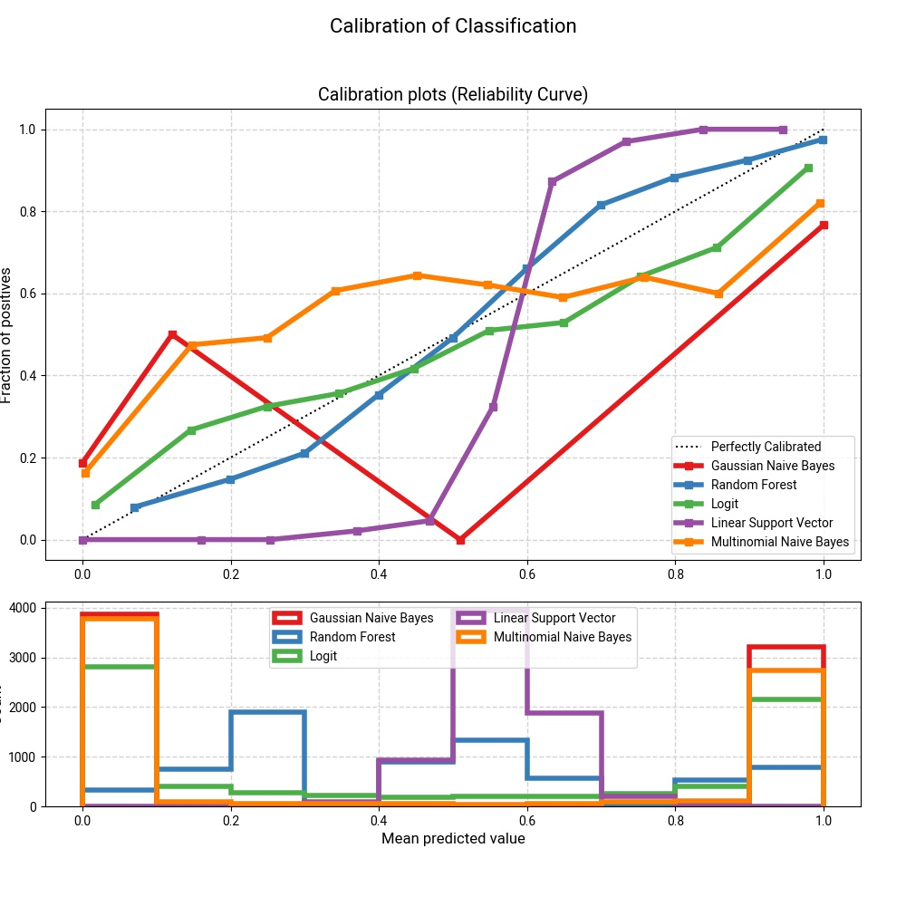
Appendix - Post-Presentation Update

Slide 29
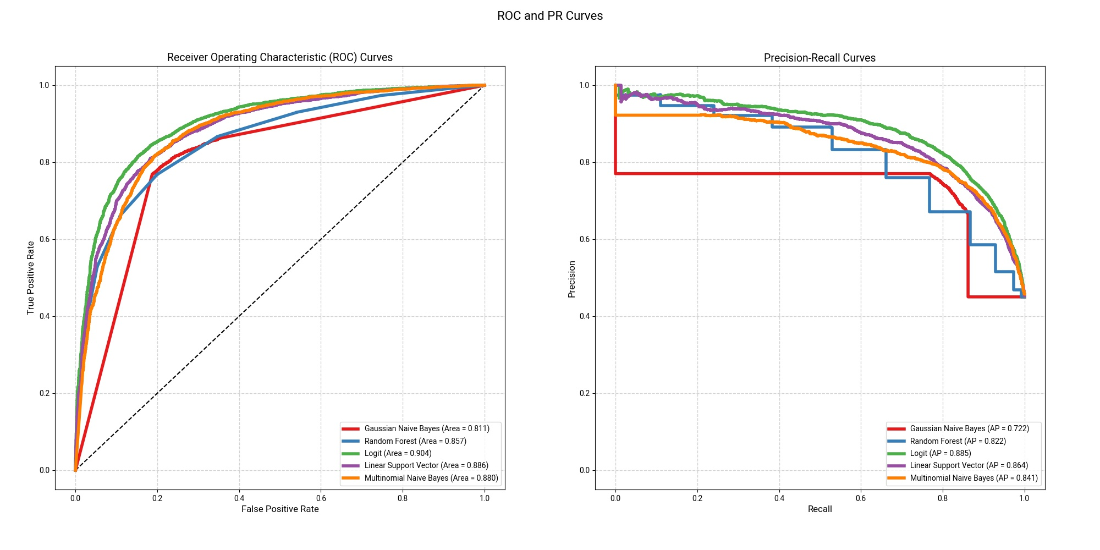
Appendix - Post-Presentation Update

Slide 30
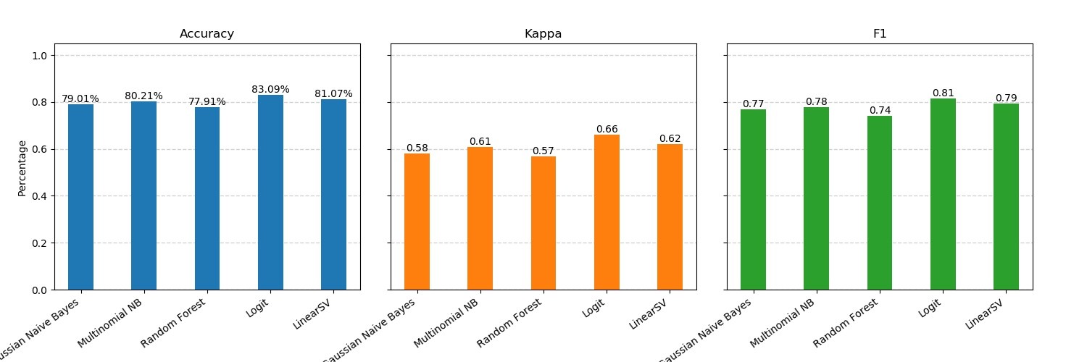
Appendix - Post-Presentation Update

Slide 31
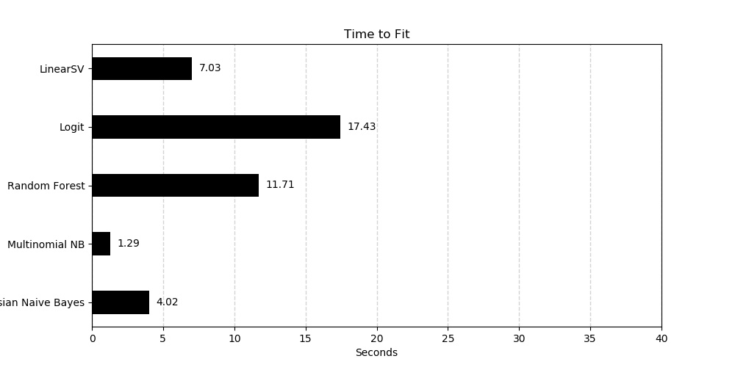
Results - Fit Time

Slide 32
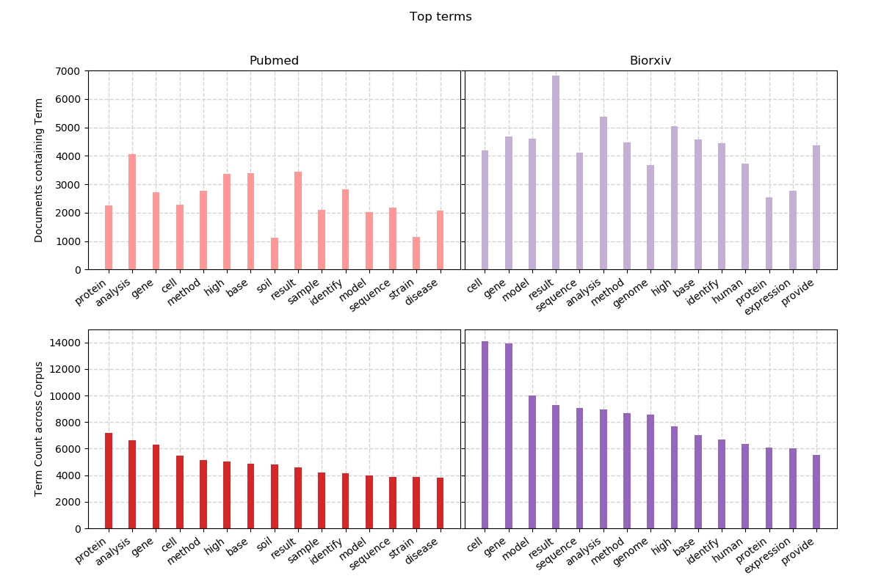
Discussion - High Frequency Terms

